Slide 1
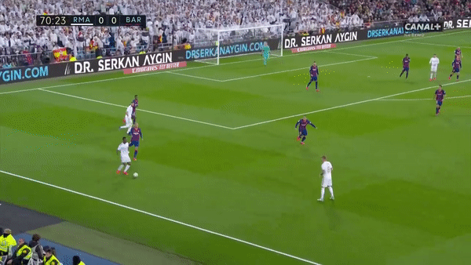
Offensive Efficiency
Slightly improving ability to beat opponents/progress the ball
At same time: declining in ability to beat opposition defense
Beaten opponents:
An opponent is bypassed if, after a pass or dribbling, they are further away from their goal than the ball and is therefore no longer able to defend the goal.
Beaten defenders:
A defender is one of the last 5 outfield players in each given scenario, closest to their own goal. They are bypassed if after a pass or dribbling, they are further away from their goal than the ball and therefore no longer able to defend the goal.

Slide 2
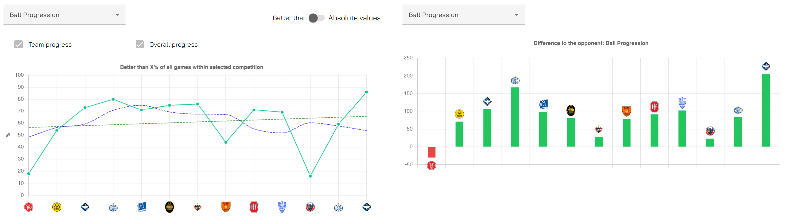
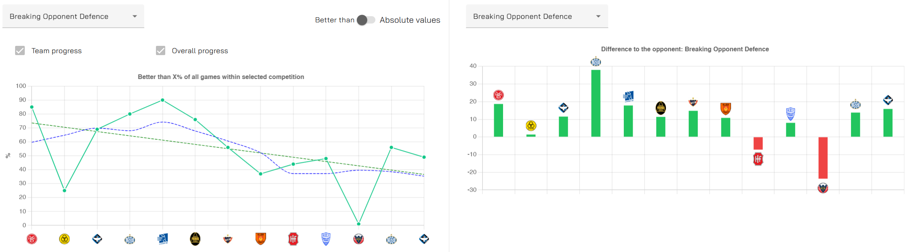

Slide 3
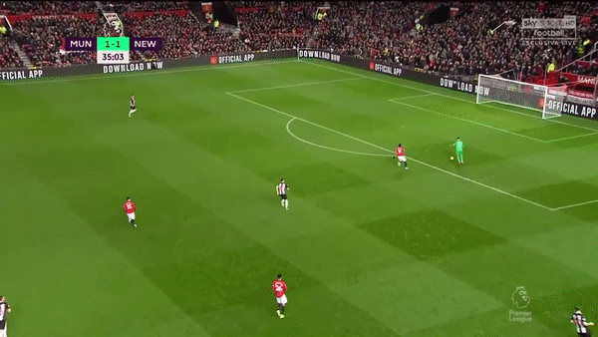
Ball Control
Becoming more wasteful in possession – losing many balls
Also declining with serious ball losses removing 4+ teammates
Defensive Ball Control (ball loss removed teammates):
A removed teammate is defined as a player who is further away from his own goal than the ball after a loss in possession. If a centre-back plays the ball that is intercepted by the opposing striker who is now free in front of goal, the centre-back has removed 10 of his teammates from the game by losing the ball, as none of them are between the ball and the goal.
Critical Ball Loss:
Number of turnovers in possession in which 4 or more teammates are removed from the game (not goal side of the ball). These ball losses are particularly serious because there are few teammates behind the ball, therefore increasing the risk of conceding a goal.

Slide 4
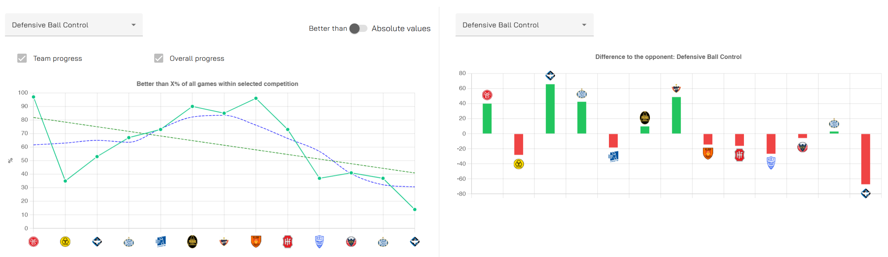
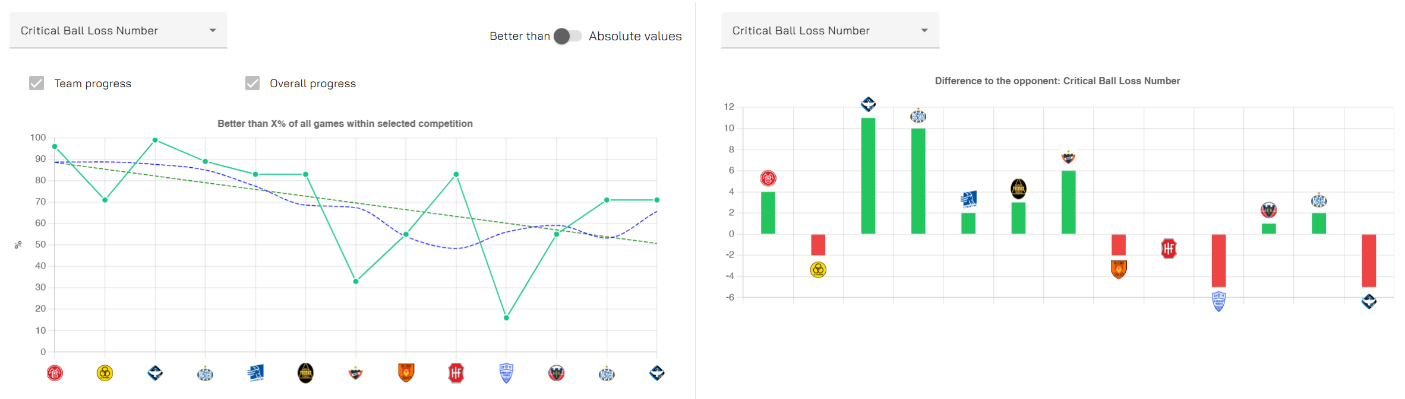

Slide 5
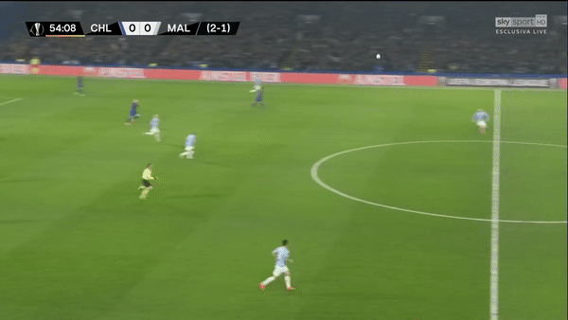
Interventions/Ball Wins
Removing fewer and fewer opponents via ball wins
Leads to removing fewer opposition defenders
  we’re worse than opponent in most games
Offensive Interventions:
Sum of opponents who, after winning possession, are further away from their own goal than the ball and can therefore no longer defend their goal.
Offensive Ball Wins From Defenders:
Sum of defenders who, after winning possession, are further away from their own goal than the ball and can therefore no longer defend their goal.
Defenders = last 5 field players in the given scenario.

Slide 6
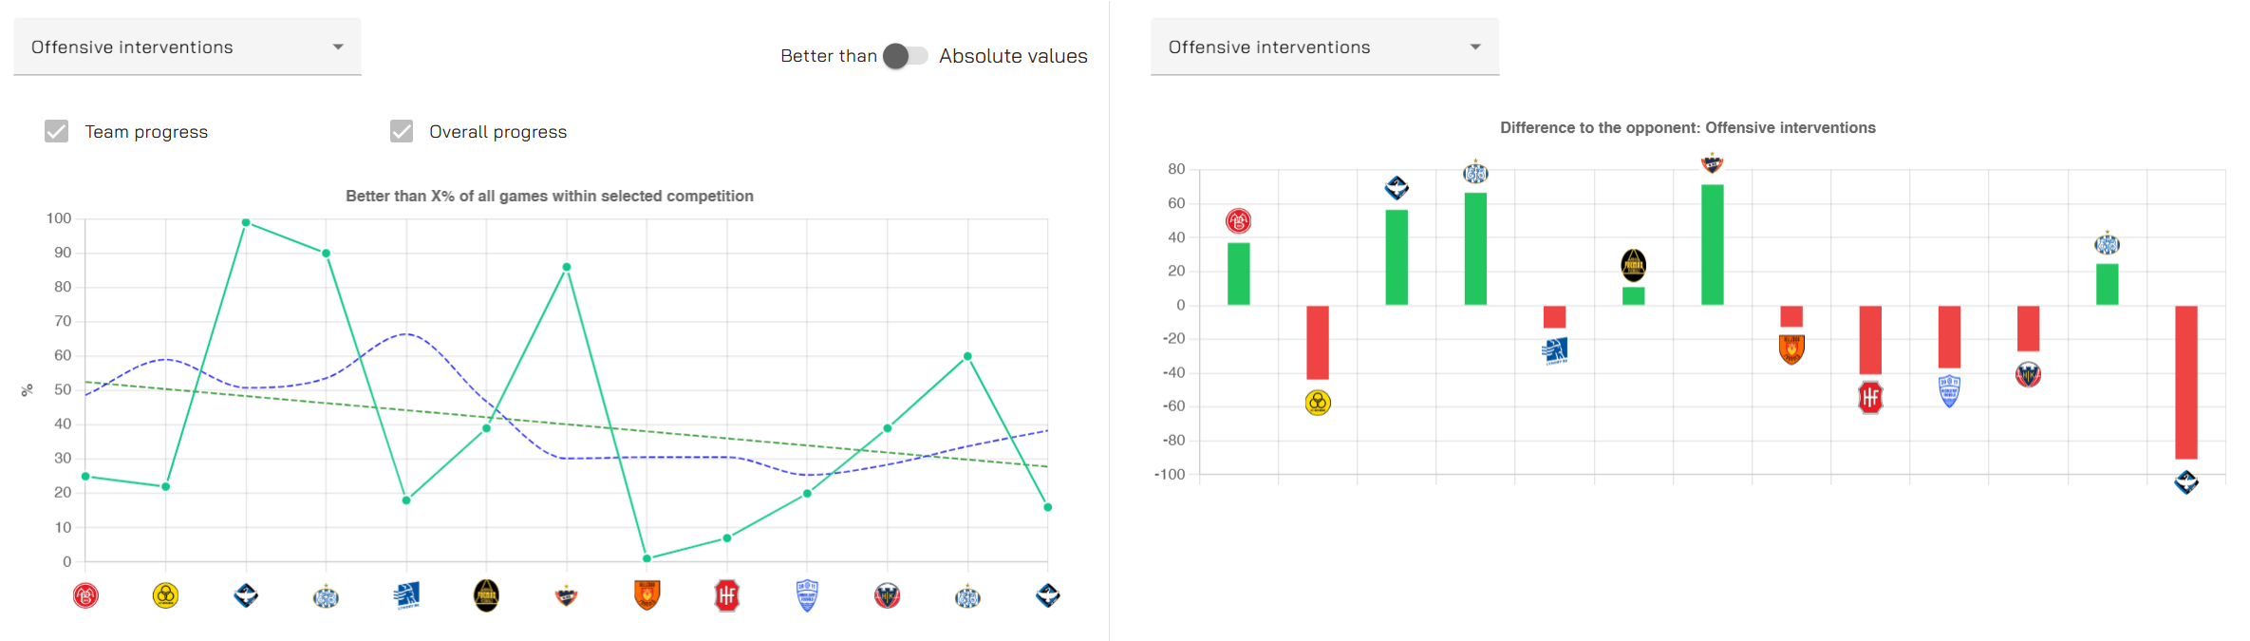
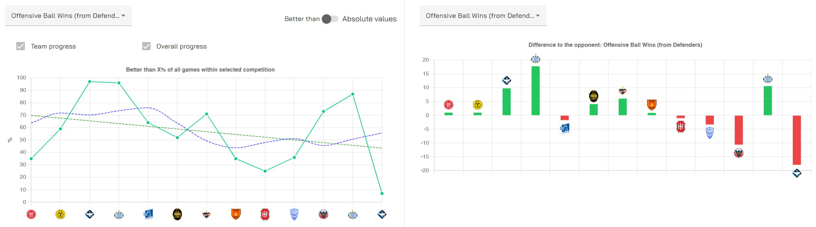

Slide 7
Duels & Second Balls
Ground duel win rate remaining consistent and above average
Consistently getting worse in the air, usually worse than 50% now
  Together, poor aerial quality leads overall duel win % to decline
However: second ball win rate improving across the season
Second Ball Phase:
Second Ball phase of the game begins after uncontrollable or extremely hard to control actions, e.g. an aerial duel or blocked pass/shot, when both teams are then in a fight for the ball. You cannot clearly assign possession of the ball to either of the two teams in these phases. The phase ends when one team manages to bring enough control over the ball (pressure <40) or there is a stoppage of play.

Slide 8
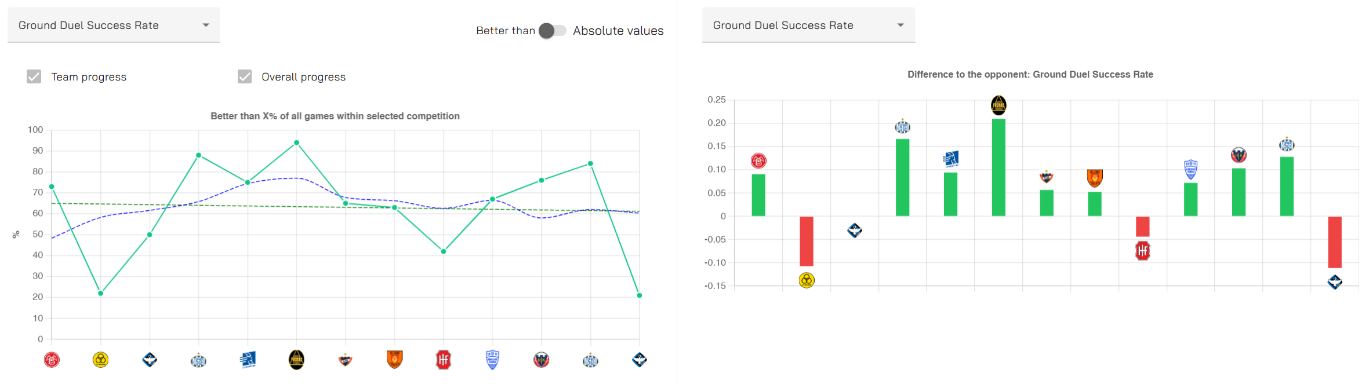
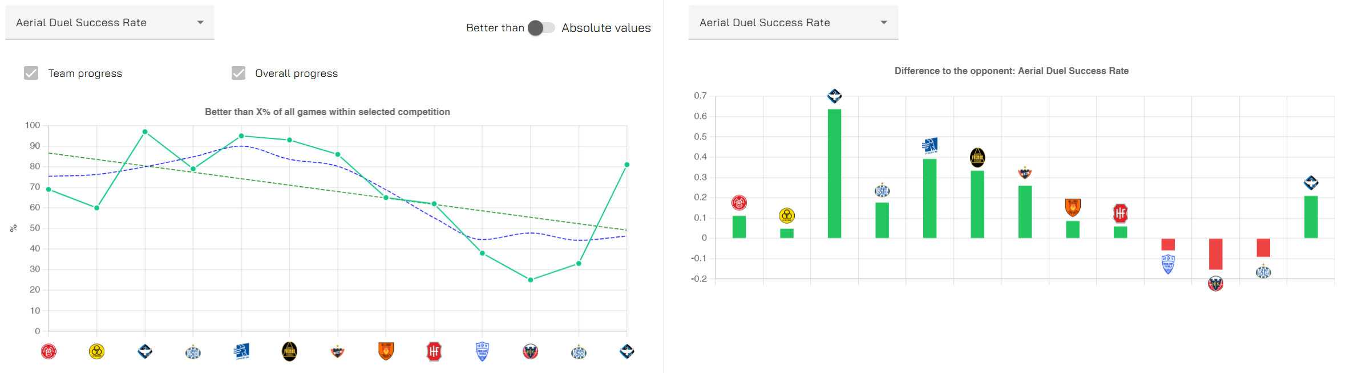

Slide 9
